Slide 1
CS118
PROGRAMMING FUNDAMENTALS

Slide 2
TEXT BOOKS
Name: C How to Program - 7th Edition Authors: Paul Deitel, Harvey Deitel Publisher: Pearson Name: Problem Solving and Programming Concept - 9th Edition Authors: Maureen Sprankle , Jim Hubbard Publisher: Prentice Hall
Reference books: Name: Working with C / Let us C Author(s): Yashwant Kanetkar Publisher: BPB Publications Name: Waite Group’s Turbo C - Programming for the PC Authors: Robert Lafore Publisher: SAMS

Slide 3
CHAPTER 1
General Problem solving concepts

Slide 4
OVERVIEW
Problem Solving in Everyday Life
Types of Problems
Problem Solving with Computers
Difficulties with Problem Solving

Slide 5
PROBLEM SOLVING IN EVERYDAY LIFE

Slide 6
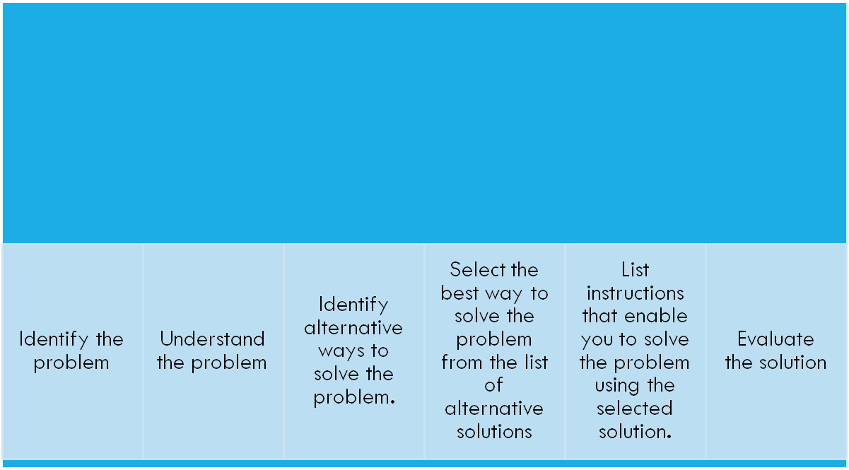
SIX STEPS OF PROBLEM SOLVING

Slide 7
THE PROBLEM OF WHAT TO DO THIS EVENING.
2. Understand the problem
3. Identify alternatives
Consider the knowledge base of the participants .
Select solutions that everyone involved would know how to do.
a game of chess, if the participants did not know how to play.
a. Watch television.
b. Invite friends over.
c. Play video games.
d. Go to the movies.
e. Play miniature golf.
f. Go to the amusement park.
g. Go to a friend’s party.
1. Identify the problem.
How do the individuals wish to spend the evening?

Slide 8
THE PROBLEM OF WHAT TO DO THIS EVENING.
4. Select the best way to solve the problem.
5. Prepare a list of steps
6. Evaluate the solution.
a. Weed out alternatives that are not acceptable, such as those that cost too much money or do not interest one of the individuals involved.
b. Specify the pros and cons of each remaining alternative.
c. Weigh the pros and cons to make the final decision
(instructions) that will result in a fun evening.
Are we having fun yet?
If nobody is having fun, then replan.
See if anything can be changed, if not then the process must start again.

Slide 9
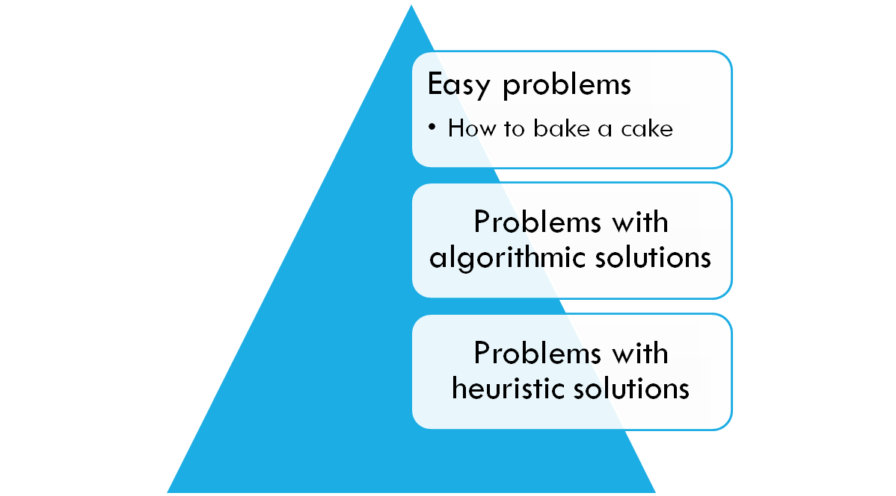
TYPES OF PROBLEMS

Slide 10
PROBLEMS WITH ALGORITHMIC SOLUTIONS
    Can be solved in a number of steps e.g. balancing a check book.
    Algorithm: A number of steps that may be performed repeatedly to reach some solution

Slide 11
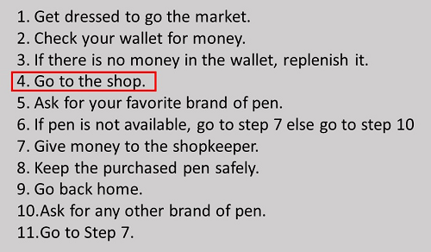
ALGORITHM FOR GOING TO THE MARKET TO PURCHASE A PEN
itself a complete task and separate algorithm can be written for it

Slide 12
PROBLEMS WITH HEURISTIC SOLUTIONS
  Solutions that cannot be reached through a direct set of steps are called heuristic solutions.
  These solutions require reasoning built on knowledge and experience, and a process of trial and error.
  Example: how to buy the best stock or whether to expand the company

Slide 13
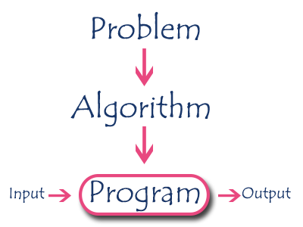
PROBLEM SOLVING WITH COMPUTERS
Output/Results
means the outcome or the completed computer-assisted answer.
Program means the set
of instructions that make up the solution after they have been coded into a particular
computer language.

Slide 14
COMPUTER PROBLEM SOLVING
Best for Algorithmic solution
  Calculating the monthly salary for employees
Not so good for Heuristic solution
E.g. the problem of how to throw a ball or how to speak English
  Artificial intelligence enables a computer to do things like build its own knowledge bank and speak in a human language.

Slide 15
DIFFICULTIES IN PROBLEM SOLVING
The problem-solving process is not easy.
takes practice and time to perfect
Poor training
Afraid to make decisions
Incorrect problem definition
Inadequate steps of algorithm

Slide 16
EXERCISE: TASK OF DECIDING WHICH NUMBER IS THE LARGEST FROM A GROUP OF THREE NUMBERS
When solving problems on the computer, most difficult tasks is
writing the instructions.
Almost anyone can immediately tell which is the largest, but many cannot explain the steps they followed to arrive at it.

Slide 17
CHAPTER 2
PROBLEM SOLVING

Slide 18
This chapter will cover the following topics:
  Problem Solving Concepts for the Computer
  Pre-Programming Phase
  Programming Or Implementation Phase

Slide 19
WHAT PROBLEM CAN BE SOLVED BY COMPUTER
When the solution can be produced by a set of step-by-step procedures or actions.
This step-by-step action is called an algorithm.
The algorithm will process some inputs and produced output.
Solving problem by computer undergo two phases:
  Phase 1:
    Organizing the problem or pre-programming phase.
  Phase 2:
    Programming phase.

Slide 20
PRE-PROGRAMMING PHASE
This phase requires five steps:
  Analyzing the problem.
  Developing the Hierarchy Input Process Output (HIPO) chart or Interactivity Chart (IC).
  Developing the Input-Process-Output (IPO) Chart.
  Drawing the Program flowcharts.
  Writing the algorithms.

Slide 21
PRE-PROGRAMMING PHASE
Analyzing The Problem
  Understand and analyze the problem to determine whether it can be solved by a computer.
  Analyze the requirements of the problem.
  Identify the following:
    Data requirement.
    Processing requirement or procedures that will be needed to solve the problem.
    The output.

Slide 22
PRE-PROGRAMMING PHASE
All These requirements can be presented in a Problem Analysis Chart (PAC)
Data | Processing | Output
given in the problem or provided by the user | List of processing required or procedures. | Output requirement.

Slide 23
PRE-PROGRAMMING PHASE
Example: Payroll Problem
  Calculate the salary of an employee who works by hourly basis. The formula to be used is
Salary = Hour works * Pay rate
Data | Processing | Output
Hours work, Pay rate | Salary = Hours work * payrate | Salary

Slide 24
PROBLEM 1
Write a Problem Analysis Chart (PAC) to convert
the distance in miles to kilometers where 1.609
kilometers per mile.
Data | Processing | Output
Distance in miles | Kilometers = 1.609 x miles | Distance in kilometers

Slide 25
PROBLEM 2
Write a Problem Analysis Chart (PAC) to find an area of a circle where area = pi * radius * radius
Data | Processing | Output
radius | area = 3.14 x radius x radius | area

Slide 26
PROBLEM 3
Write a Problem Analysis Chart (PAC) to compute and display the temperature inside the earth in Celsius and Fahrenheit. The relevant formulas are
Celsius = 10 x (depth) + 20
Fahrenheit = 1.8 x (Celsius) + 32
Data | Processing | Output
depth | celsius = 10 x (depth) + 20 fahrenheit = 1.8 x (celsius) + 32 | Display celsius, Display fahrenheit

Slide 27
PROBLEM 4
Write a problem analysis chart (PAC) that asks a user to enter the distance of a trip in miles, the miles per gallon estimate for the user’s car, and the average cost of a gallon of gas. Calculate and display the number of gallons of gas needed and the estimated cost of the trip.

Slide 28
Data | Processing | Output
distance, miles per gallon, cost per gallon | gas needed = distance / miles per gallon. estimated cost = cost per gallon x gas needed | Display gas needed Display estimated cost

Slide 29
PRE-PROGRAMMING PHASE
Developing the Hierarchy Input Process Output (HIPO) or Interactivity Chart
  The problem is normally big and complex.
  Thus, requires big program.
  Thus, the processing can be divided into subtasks called modules.
  Each module accomplishes one function.
  These modules are connected to each other to show the interaction of processing between the modules.

Slide 30
PRE-PROGRAMMING PHASE
Main/control module controls the flow all other modules.
The IC is developed using top-down-method: top to down left to right order (also refer to order of processing).
Modules are numbered, marked for duplication, repetition or decision.

Slide 31
PRE-PROGRAMMING PHASE
The interaction will form a hierarchy, called Hierarchy Input Process Output Chart (HIPO) or Interactivity Chart (IC). Programming which use this approach (problem is divided into subtasks) is called Structured Programming.
Main Module
Module 1
Module 2
Module 3
Module 4
Module 5
Module 6

Slide 32
PRE-PROGRAMMING PHASE
PAYROLL
0000
READ
1000
CALCULATE
2000
PRINT
3000

Slide 33
PRE-PROGRAMMING PHASE
Example 2.2: Extended Payroll Problem
You are required to write a program to calculate both the gross pay and the net pay of every employee of your company. To determine the gross pay, you have to multiply the accumulated total hours worked by the employee, by the appropriate pay rate. The program should print the cheque that tells the total net pay. The net pay is calculated by subtracting the gross pay with any deductions that may be incurred by the employee.

Slide 34
PRE-PROGRAMMING PHASE
Payroll
0000
Calculate
Gross Pay
1000
Calculate
Net Pay
2000
Write
Cheque
3000
Accumulate
Hourly
Worked
1100
Determine
Pay rate
1200
Calculate
Deductions
2100

Slide 35
PROBLEM 1
Write a Hierarchy Input Process Output (HIPO) to convert
the distance in miles to kilometers where 1.609
kilometers per mile.
Convert the distance
0000
Distance in miles
1000
Kilometers = 1.609
x miles
2000
Distance in
Kilometers
3000

Slide 36
PROBLEM 2
Write a Hierarchy Input Process Output (HIPO) to find an area of a circle where area = pi * radius * radius
Area
0000
radius
1000
area = 3.14 x
radius x radius
2000
Display area
3000

Slide 37
PROBLEM 3
Write a Hierarchy Input Process Output (HIPO) to compute and display the temperature inside the earth in Celsius and Fahrenheit. The relevant formulas are
Celsius = 10 x (depth) + 20
Fahrenheit = 1.8 x (Celsius) + 32
Temperature
0000
Calculate temperature
in celsius
1000
Calculate temperature
In fahrenheit
2000
Display
Temperature
3000
Get depth
1100

Slide 38
PROBLEM 4
Write a Hierarchy Input Process Output (HIPO) that asks a user to enter the distance of a trip in miles, the miles per gallon estimate for the user’s car, and the average cost of a gallon of gas. Calculate and display the number of gallons of gas needed and the estimated cost of the trip.

Slide 39
Estimation Cost
0000
Calculate gas
Needed
1000
Calculate estimated
Cost
2000
Display gas needed
Display estimated
Cost
3000
Get total distance
in miles
1100
Get miles
per gallon
1200
Get average cost
per gallon
2100

Slide 40
PRE-PROGRAMMING PHASE
Developing the Input Process Output (IPO) Chart
  Extends and organizes the information in the Problem Analysis Chart.
  It shows in more detail what data items are input, what are the processing or modules on that data, and what will be the result or output.
  It combines information from PAC and HIPO Chart.

Slide 41
PRE-PROGRAMMING PHASE
Input | Processing | Module | Output
-Hours Worked -Pay Rate -Deduction | -Enter Hourly Worked -Enter Pay Rate -Calculate Gross Pay -Enter Deductions -Calculate Net Pay -Print Cheque -End | 1100 1200 1000 2100 2000 3000 0000 | -Net pay

Slide 42
PROBLEM 1
Write a Input Process Output (IPO) to convert
the distance in miles to kilometers where 1.609
kilometers per mile.
Input | Processing | Module | Output
-Distance in Miles | -Enter distance -Kilometers = 1.609 x distance -Display kilometers | 1000 2000 3000 | -Distance in kilometers

Slide 43
PROBLEM 2
Write a Input Process Output (IPO) to find an area of a circle where area = pi * radius * radius
Input | Processing | Module | Output
- radius | - Enter radius - area = 3.14 x radius x radius Display area end | 1000 2000 3000 0000 | - Area of a circle

Slide 44
PROBLEM 3
Write an Input Process Output (IPO) to compute and display the temperature inside the earth in Celsius and Fahrenheit. The relevant formulas are
Celsius = 10 x (depth) + 20
Fahrenheit = 1.8 x (Celsius) + 32

Slide 45
PROBLEM 4
Write an Input Process Output (IPO) that asks a user to enter the distance of a trip in miles, the miles per gallon estimate for the user’s car, and the average cost of a gallon of gas. Calculate and display the number of gallons of gas needed and the estimated cost of the trip.

Slide 46
Input | Processing | Module | Output
Distance in miles Miles per gallon Cost gas per gallon | Enter distance Enter miles per gallon Calculate total gas needed Enter cost gas per gallon Calculate estimated cost Display total gas and estimated cost End | 1100 1200 1000 2100 2000 3000 0000 | Total gas needed Estimated cost

Slide 47
PRE-PROGRAMMING PHASE
Drawing the Program Flowcharts
  Flowchart is the graphic representations of the individual steps or actions to implement a particular module.
  The flowchart can be likened to the blueprint of a building. An architect draws a blueprint before beginning construction on a building, so the programmer draws a flowchart before writing a program.
  Flowchart is independent of any programming language.

Slide 48
PRE-PROGRAMMING PHASE
  Flowchart is the logical design of a program.
  It is the basis from which the actual program code is developed.
  Flowchart serves as documentation for computer program.
  The flowchart must be drawn according to definite rules and utilizes standard symbols adopted internationally.
  The International Organization for Standardization (IOS) was the symbols shown below (You can draw the symbols using ready-made flowcharting template):

Slide 49
PRE-PROGRAMMING PHASE
Symbol | Function
 | Show the direction of data flow or logical solution.
 | Indicate the beginning and ending of a set of actions or instructions (logical flow) of a module or program.
 | Indicate a process, such as calculations, opening and closing files.

Slide 50
PRE-PROGRAMMING PHASE
 | Indicate input to the program and output from the program.
 | Use for making decision. Either True or False based on certain condition.
 | Use for doing a repetition or looping of certain steps.
 | Connection of flowchart on the same page.
 | Connection of flowchart from page to page.

Slide 51
PRE-PROGRAMMING PHASE
Example 2.3 : Sale Problem
  Draw a flowchart for a problem that to read two numbers. The first number represents the unit price of a product and the second number represents the quantity of the product sold. Calculate and print the total sale.
  Solution: Stepwise Analysis of the Sale Problem
    Start of processing
    Read the unit price
    Read the quantity
    Calculate total sale
    Print total sale
    Stop the processing

Slide 52
PRE-PROGRAMMING PHASE
START
A
READ
UNIT PRICE
TOTAL SALE =
UNITPRICE × QUANTITY
READ
QUANTITY
PRINT
TOTALSALE
A
STOP

Slide 53
PRE-PROGRAMMING PHASE
Finding Average Problem
  Read a sequence of number, find the average of the number and print the average.
  Solution: Stepwise Analysis of Average Problem
    Start the processing
    Read a number
    Add the number
    Repeat reading until last data
    Calculate the average
    Print the average
    Stop the processing

Slide 54
PRE-PROGRAMMING PHASE
START
READ
NUMBER
ACCUMULATE
TOTAL
Repetition until end of data
CALCULATE
AVERAGE
PRINT
AVERAGE
STOP

Slide 55
PRE-PROGRAMMING PHASE
START
X
COUNTER
= ∅
AVERAGE = TOTAL
COUNTER
READ NUMBER
PRINT AVERAGE
TOTAL = TOTAL + NUMBER
COUNTER = COUNTER + 1
STOP
END OF DATA
X

Slide 56
START
B
COUNTER
= ∅
AVERAGE = TOTAL
COUNTER
PRINT
AVERAGE
TOTAL
= ∅
A
STOP
READ
NUMBER
NUMBER =
-999999
B
COUNTER = COUNTER + 1
TOTAL = TOTAL + NUMBER
A

Slide 57
PRE-PROGRAMMING PHASE
Writing the Algorithm (Pseudocode)
  Pseudocode means an imitation computer code.
  It is used in place of symbols or a flowchart to describe the logic of a program. Thus, it is a set of instructions (descriptive form) to describe the logic of a program.
  Pseudocode is close to the actual programming language.
  Using the Pseudocode, the programmer can start to write the actual code.

Slide 58
START
READ
PRICE
Algorithm:
Start Read price, quantity
Sale = price x quantity
Print Sale End
READ
QUANTITY
SALE = PRICE ×
QUANTITY
PRINT
SALE
STOP

Slide 59
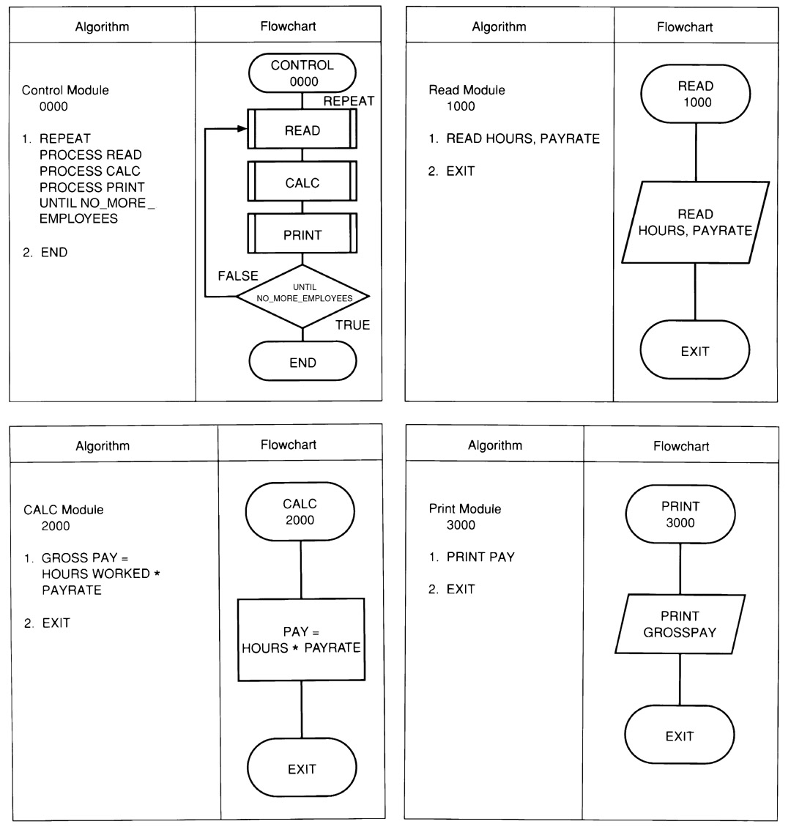
Example: Flowchart & Algorithm

Slide 60
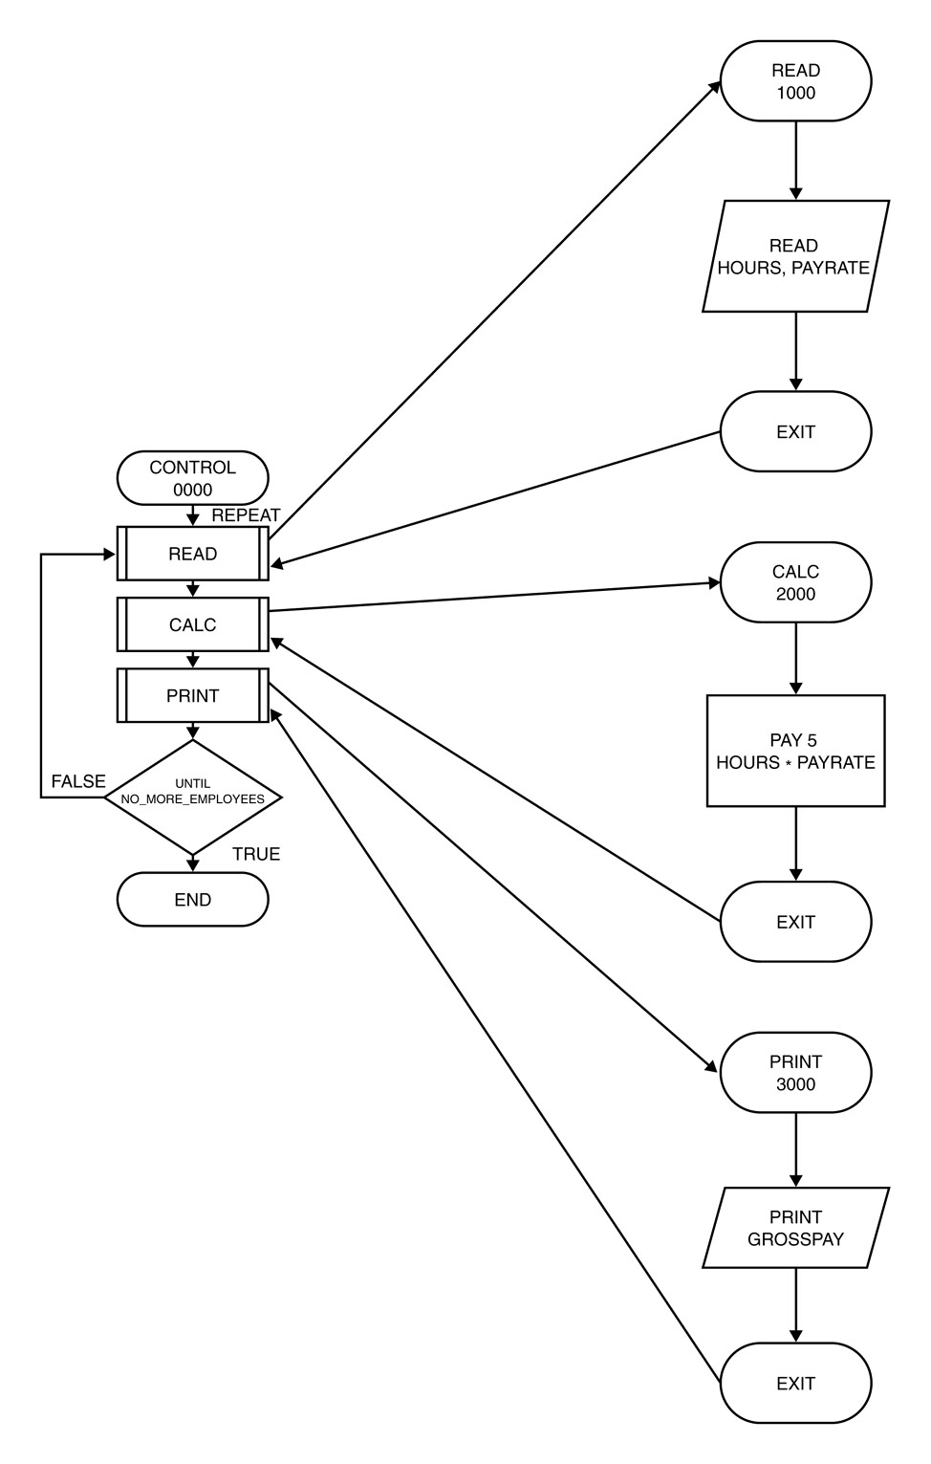
ORDER OF EXECUTION OF INSTRUCTIONS : PAYROLL SYSTEM

